Slide 1
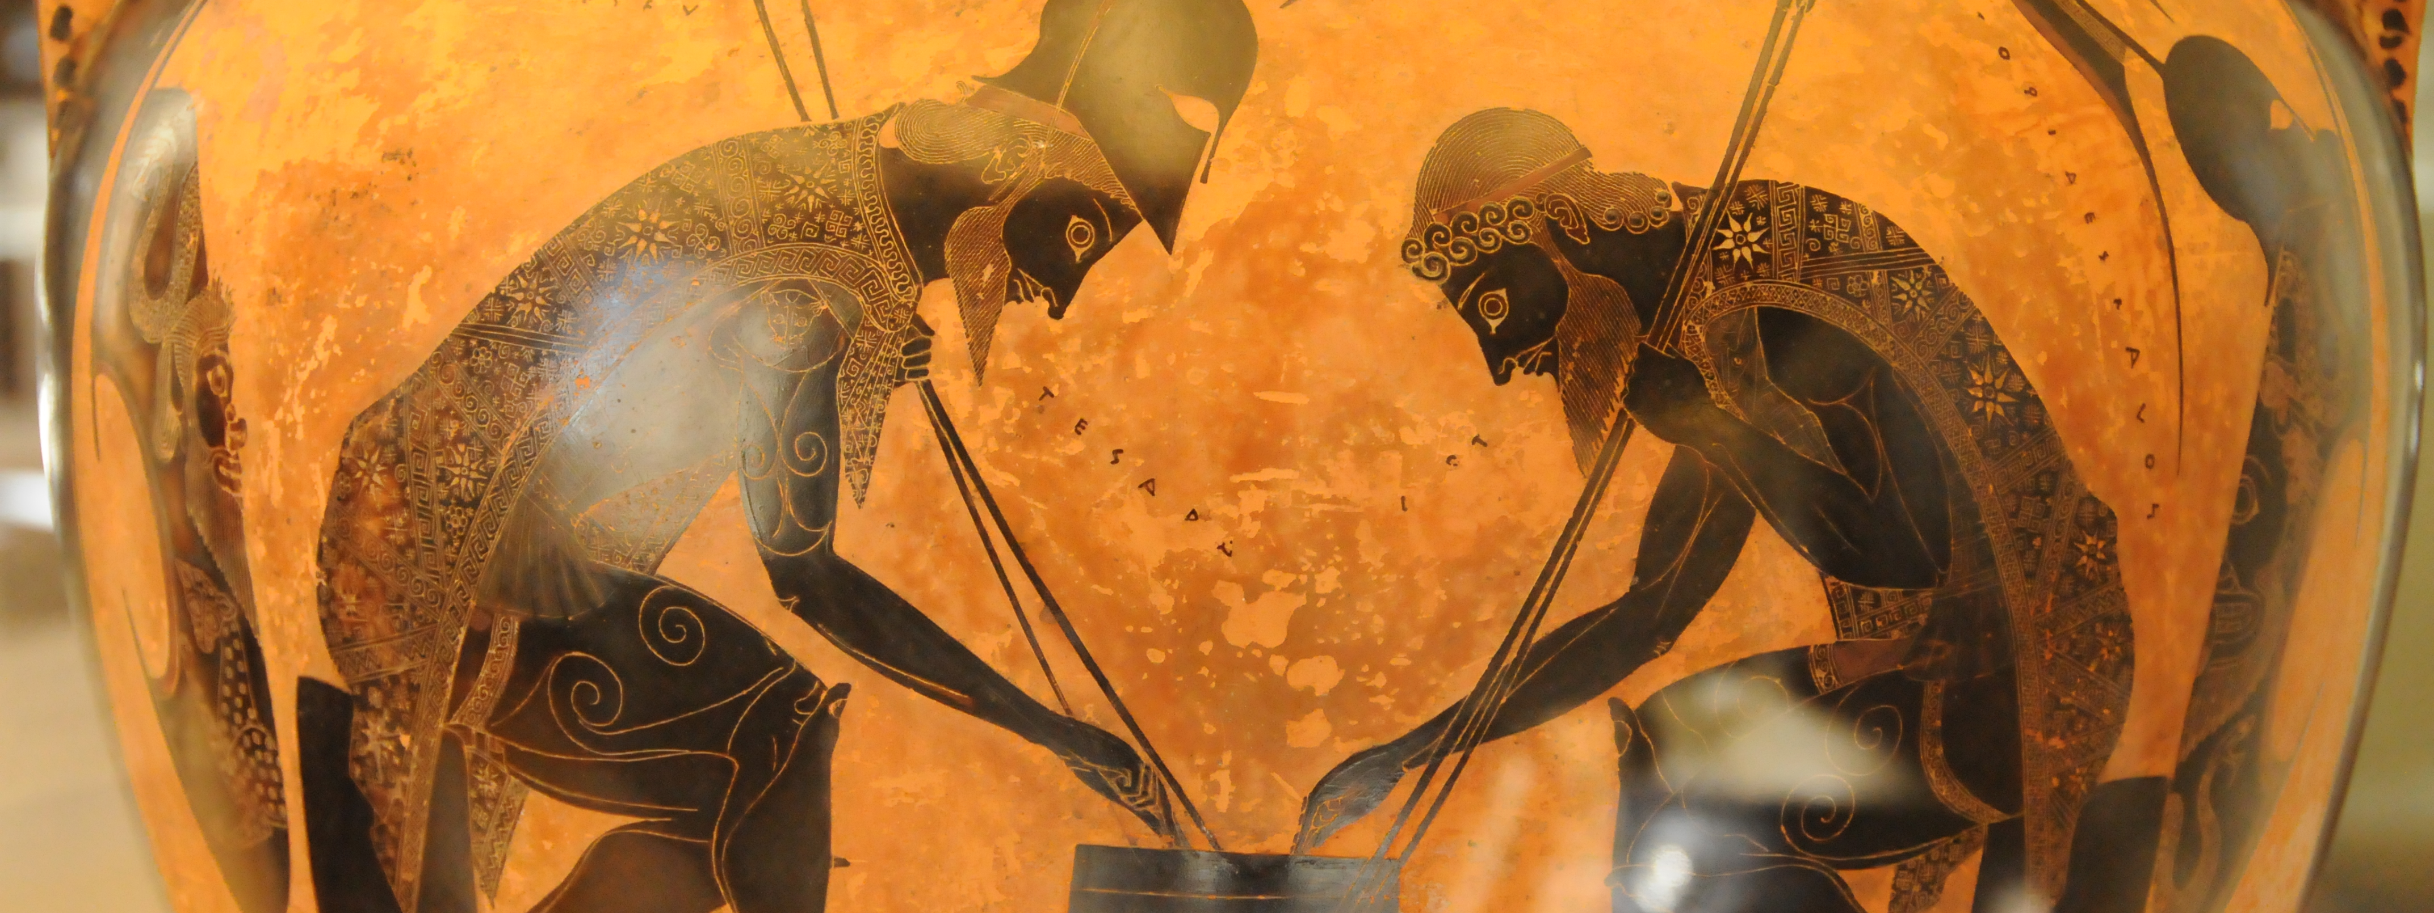
XML and TEI
Part 1: Introduction to XML
Part 1
Adapted from The Women
Writers Project and the
Occom Letter Project
Notes:
This is a gentle introduction adapted from several longer course I have taken. Specifically, it is adapted from University of Virginia’s XML in Action and the Women Writers Project. It is not meant to be comprehensive.
Part 1 is designed to introduce you to the basic concepts of XML and prepare you for marking up texts using TEI. Part 2 will unpack the TEI.

Slide 2
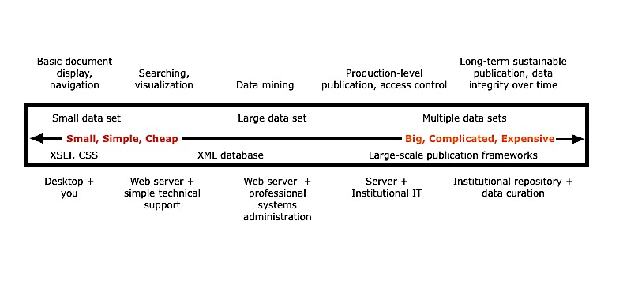
The Emerging Digital Humanities lifecycle
Image from the Women Writers Project
Notes:
So why are you being forced to learn this? And more importantly, why am I here. Well, increasingly humanities work is being informed by, and taking advantage of computers. And digital projects in the humanities seem to follow a lifecycle that looks a lot like this diagram. At the end of our time, you will have he basic building blocks to create a small micro DH data set. That micro DH project could ultimately end up as a capstone which needs stewarding and curating in order to be ingested into the Institutional Repository.

Slide 3
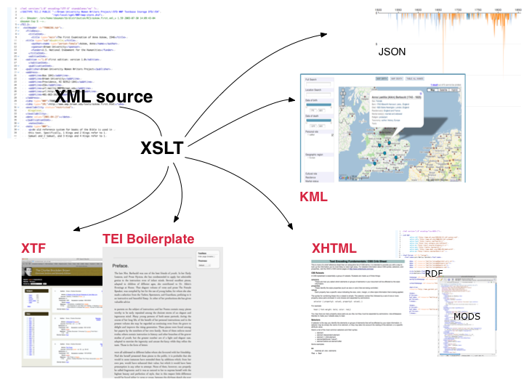
Xml: The Elevator Speech
Image from the Women Writers Project
Notes:
The Extensible Markup Language (XML) is a markup language that defines a set of rules for encoding documents in a format that is both human-readable and machine-readable.
XML is a markup language that defines a set of rules for encoding documents that is both human and machine-readable. That is, XML is a standard for constructing your tags that describes the structure of a document, rather than just its appearance. It is a simple, flexible and customizable.
XML 1.0 became a W3C Recommendation 19 years ago on February 10, 1998.
Note: A markup language is a system for annotating a document that is syntactically distinguishable from the text. This makes XML particularly powerful. Its an “uber-document” if you will, that can be unlocked in multiple ways.

Slide 4
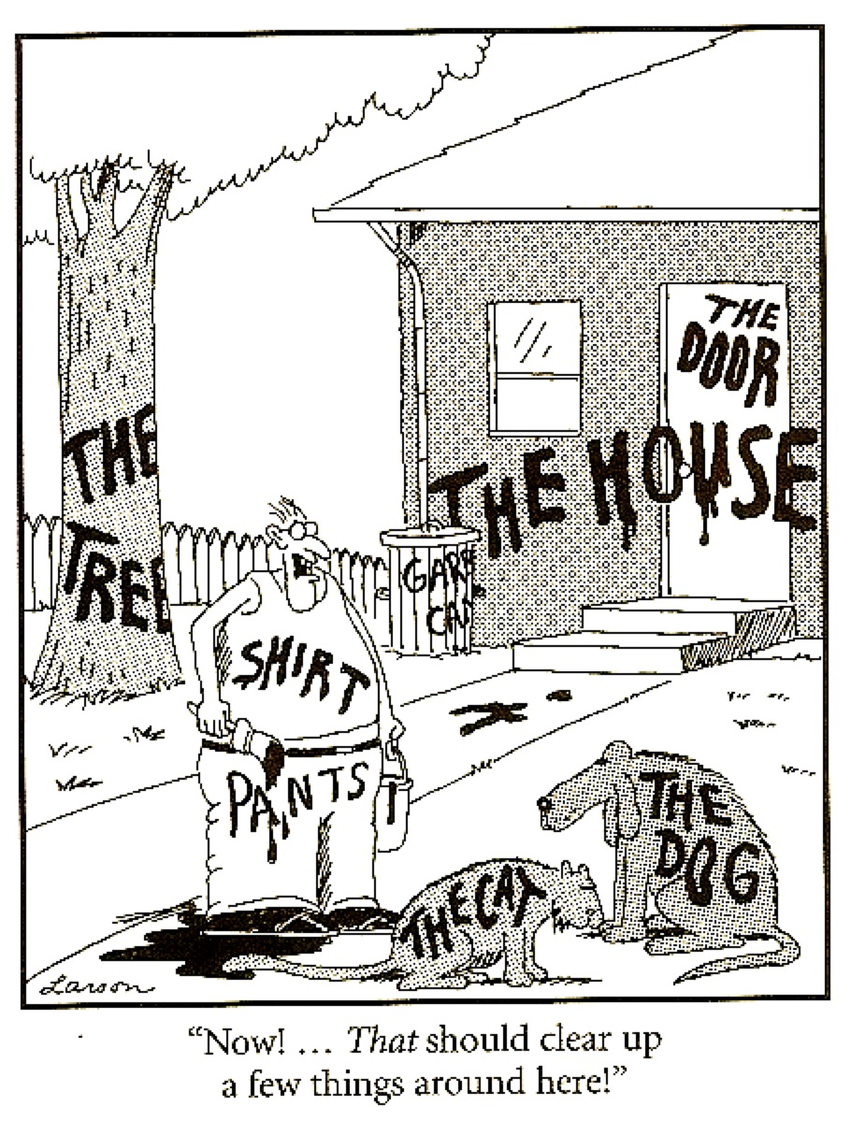
A Gentle introduction
One way to understand what XML does is to think about it as a way of structuring, or organizing information.
Structure is what makes digital information useful to us; it helps us find things, it helps us identify them and understand what they are, and it helps us communicate about them to other people.
Notes:
Note: When structuring information, it is more important to be consistently wrong than inconsistently right.

Slide 5
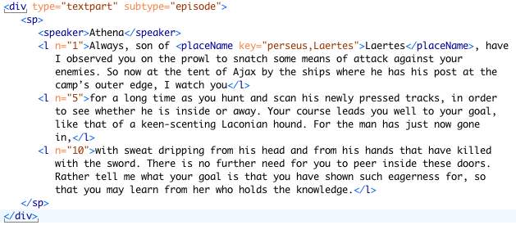
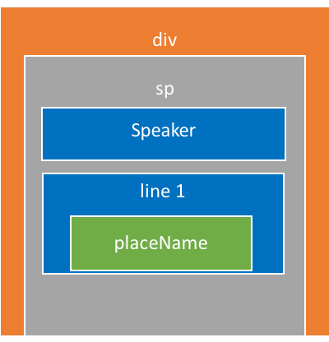
Xml as a means of structuring information
Notes:
XML provides a very specific way of structuring information and of looking at the world. It asks us to identify pieces of information that we are interested in, and it asks us to group them together. We can represent these groupings in various different visual ways, all of which represent the same thing—XML’s structure. The first useful metaphor is that of a set of nested boxes, like in this example. These boxes always nest perfectly within each other, and do not overlap.

Slide 6
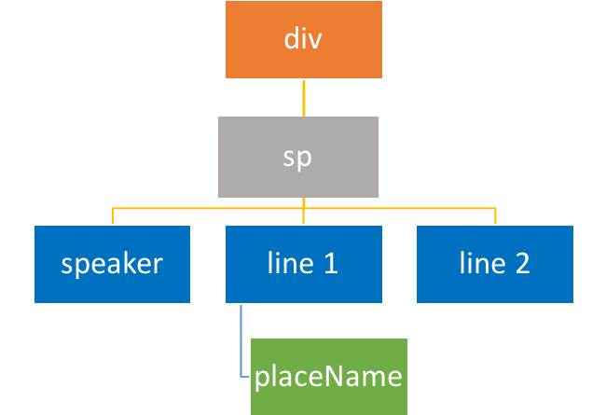
Xml as a means of structuring information
Notes:
You can also think about the structure of XML as being like a tree. Each XML document is a complete tree, and each XML element is like a branch of that tree. The example on the right shows XML as it is written, using a system of tags that mark the boundaries of the boxes and the structural groupings that make up the informational system. Each box or tree node (or element in XML parlance) is represented by a pair of tags that mark its beginning and its end, and these elements can be nested inside one another.

Slide 7

The relationship between xml and TEI
XML
Syntax
<?xml version="1.0" encoding="UTF-8"?>
<root>
<element>Content
<element attribute = "value">More content.</element>
</element>
</root>
TEI
Schema
…
<body>
<div type="chapter">
<head>After nones</head>
<p> I leafed through the catalogue, and a feast of mysterious titles danced before my eyes.</p>
</div>
</body>
Chapter
Head
Paragraph
XML defines a syntax for text encoding. It is a method for distinguishing our markup from the content that we are marking up. The TEI provides the specifics of the actual encoding language. It translates our concepts into XML, and provides a controlled vocabulary that we use in marking up the text.
Notes:
Today we will mostly be looking at the syntax of xml, and the rules for creating xml documents.

Slide 8
So what does this Really look like….
XML declaration
Specifies that the document uses a subset of TEI P5 elements called Epidoc, and further, is a subset of those rules, specific to Brown—your processor will validate against this.
<?xml version="1.0" encoding="UTF-8"?>
<?oxygen RNGSchema="http://cds.library.brown.edu/projects/usepigraphy/schema/exp-epidoc.rng" type="xml"?>
<TEI xmlns="http://www.tei-c.org/ns/1.0" xmlns:xi="http://www.w3.org/2001/XInclude">
<teiHeader>
<fileDesc>
<titleStmt>
<title>MD.Balt.JHU.L.119c</title>
</titleStmt>
<!—publicationStmt start here -->
<publicationStmt>
<authority>Brown University &amp; Tufts University</authority>
<idno type="USEpigraphy" xml:id="MD.Balt.JHU.L.119c">Repeat USEP ID</idno>
</publicationStmt>
…
Root element
TEI namespace attributes
Comment
Predefined Entity
Tag
Attribute
Attribute Value
Notes:
Note the root element. This is absolutely necessary to create xml.
Our root element declares that this document uses the TEI
There are five predefined entities:
&lt; represents "<";
&gt; represents ">";
&amp; represents "&";
&apos; represents "'";
&quot; represents '"'.
The EpiDoc schema, the set of rules that tells an XML editor or processor what elements, attributes and other content are available in an EpiDoc file
XML processors are classified as validating or non-validating depending on whether or not they check XML documents for validity. A processor that discovers a validity error must be able to report it, but may continue normal processing.

Slide 9
Let’s Break that down
Tags, elements, attributes &amp; predefined entities

Slide 10
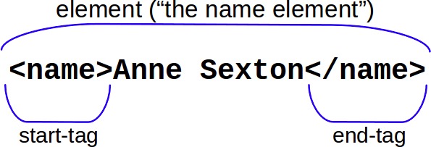
Tags and Elements
In XML, we mark the boundaries of elements with tags. These also serve as a label for the element. We should also note that tags in XML are not just important for us as readers (serving as human-readable labels for the features we choose to mark). XML tags are also important for the processor. The brackets and the forward-slashes serve to delimit the element, and allow the processor to differentiate elements from the content.
Image from the Women Writers Project
Notes:
Elements and attribute names must follow these rules:
They may contain letters, numbers, ideographs
They may not contain white space, or punctuation other than hyphen, period, and underscore
They must begin with a letter or underscore.

Slide 11
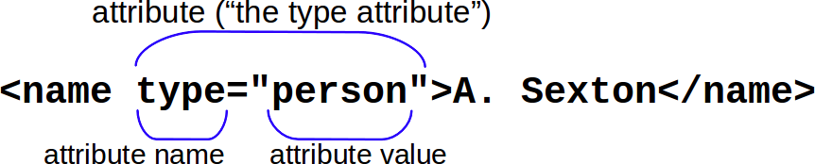
attributes
An XML attribute is like an adjective to the element’s noun, in that it modifies an element. However, attributes are a bit more detailed than adjectives. They tell you what aspect of the element they’re describing, like its type, or its size, or its color (the name of the attribute) and the specific descriptor within that category of information (the attribute value).
Image from the Women Writers Project
Notes:
Elements and attribute names must follow these rules:
They may contain letters, numbers, ideographs
They may not contain white space, or punctuation other than hyphen, period, and underscore
They must begin with a letter or underscore.

Slide 12
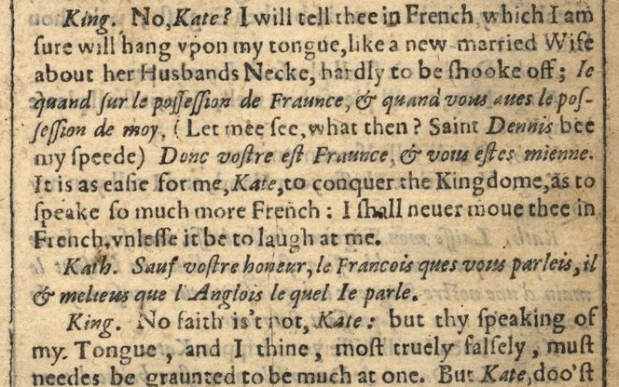
Predefined Entities
There are five predefined entities:
&lt; represents "<";
&gt; represents ">";
&amp; represents "&";
&apos; represents "'";
&quot; represents '"'.

Slide 13
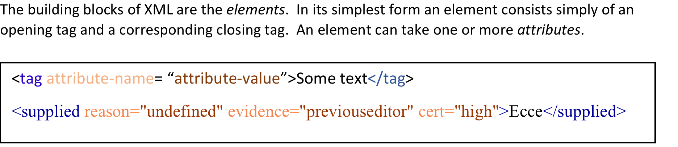
recap
Notes:
Elements and attribute names must follow these rules:
They may contain letters, numbers, ideographs
They may not contain white space, or punctuation other than hyphen, period, and underscore
They must begin with a letter or underscore.

Slide 14
Let’s Expand on that
‘Well-Formedness’ and Validity
Notes:
“Well-formedness” are the basic rules for XML to be, XML. Validity is a set of further rules that are defined by schemas, DTDs, RELAXNG, that tell your processor what elements, attributes, and even attribute values are valid, and when they an be used. That is, validity is about the rules you, or your community defines.

Slide 15
Rules – Well-Formedness
“Well-formedness” means:
Everything is properly delimited
A single (one and only one) root element
No overlap
These rules come from the W3C standard for XML, so all XML documents need to follow these three rules. These are specifically called the rules of “well-formedness”, and every XML language—from TEI to HTML to MathML—must follow these rules.
The first is that all elements must be properly delimited, i.e. they must contain all necessary characters (such as pointy brackets, quotation marks, forward slashes) in the appropriate places.
The second rule is that all documents must have a single root element, or there must be one and only one outermost wrapper element that encloses the whole document. One way to think about this rule is by thinking about XML as a tree.
Finally, XML cannot overlap. Basically this means that elements must be contained completely within each other. You cannot have a said element that begins in the middle of one <p> element and ends in the next.

Slide 16
Well-formedness
<name type="person>Pearl S. Buck</name>
<name type="person">Toni Morrison<name>
<name="person">Carl Sagan</name>
<name type="person">Kurt Vonnegut</name>
<name type=person>John Cleese</name>
<name type="person"><forename>Frances</forename>
<surname>Perkins</surname></name>
<?xml version="1.0" encoding="UTF-8"?> <item>No overlap!</item> <item>One root element!</item> <item>All delimiters!</item>
<?xml version="1.0" encoding="UTF-8"?> <lg type="poem"> <l>There was an old man with a beard</l> <l>Who said, <said>It is just as I feared;</l> <l>Two Owls and a Hen,</l> <l>Four Larks and a Wren,</l> <l>Have all made their nests in my beard!</said></l> </lg>
Take a minute to go through these examples and determine which snippets of XML are well-formed and which ones aren’t. This will help to solidify your understanding of XML syntax. As a plus: it will help you with troubleshooting when you begin to encode your own TEI documents!
Notes:
Elements and attribute names must follow these rules:
They may contain letters, numbers, ideographs
They may not contain white space, or punctuation other than hyphen, period, and underscore
They must begin with a letter or underscore.

Slide 17
Well-formedness
Answer key:
1. Ill-formed - there is a missing quote after the attribute value.
2. Ill-formed - end-tag is missing slash, so processor will think it’s just a new start tag!
3. Ill-formed - missing attribute name. The processor will only allow an equals sign if there is whitespace between the element name and attribute name (and, of course, attribute name must be present!)
4. Well-formed!
5. Ill-formed - the quotes around the attribute value are missing.
6. Well-formed! All of the necessary characters are included in the correct places. Additionally, there is a singular root element.
7. Ill-formed - Although each individual element is written out correctly, there is no root element to tie them all together.
8. Ill-formed - this is an example of XML overlap. As you can see, the said tag crosses the boundaries of an several l tags (i.e. it starts in the middle of an <l> element, and doesn’t end until after the end of that element). Remember that elements need to nest perfectly inside each other (no overlap!).
<name type="person>Pearl S. Buck</name>
<name type="person">Toni Morrison<name>
<name="person">Carl Sagan</name>
<name type="person">Kurt Vonnegut</name>
<name type=person>John Cleese</name>
<name type="person"><forename>Frances</forename>
<surname>Perkins</surname></name>
<?xml version="1.0" encoding="UTF-8"?> <item>No overlap!</item> <item>One root element!</item> <item>All delimiters!</item>
<?xml version="1.0" encoding="UTF-8"?> <lg type="poem"> <l>There was an old man with a beard</l> <l>Who said, <said>It is just as I feared;</l> <l>Two Owls and a Hen,</l> <l>Four Larks and a Wren,</l> <l>Have all made their nests in my beard!</said></l> </lg>
Notes:
Elements and attribute names must follow these rules:
They may contain letters, numbers, ideographs
They may not contain white space, or punctuation other than hyphen, period, and underscore
They must begin with a letter or underscore.

Slide 18
Rules – Validity
In addition to well-formedness, there is also validity which requires conforming to the rules of a specific language, such as TEI.
These rules are very similar to the rules for speaking in a human language: am I using the right words? and am I using them in the correct manner?
When we check an XML document for validity, we are making sure that the document obeys the rules of a specific language.
Validity means:
Correct vocabulary: all elements and attributes actually exist in that language
Correct grammar: elements are used in the right place, in the right order
Notes:
Well-formedness are the basic rules of all xml, you can further constrain it with your own rules, or schema. The schema in this class will be epiDoc, which provides the rules for what elements and attributes we can use, as well as in which order you can use them.

Slide 19
Validity
datatypes xsd = "http://www.w3.org/2001/XMLSchema-datatypes" start = element letter { date, salutation, paragraph+, signature } date = element date { text } paragraph = element paragraph { stuff* } signature = element signature { stuff* } salutation = element salutation { stuff* } stuff = text | name name = element name { text }
Validity is determined by a schema, which defines the specific rules for an encoding language. Take a minute to look over the rules in this schema, and then see how they are applied:
A letter must begin with a date, followed by a salutation, at least one paragraph, and a signature
A date may contain transcribed text
A paragraph may contain names and transcribed text
A signature may contain names and transcribed text
A salutation may contain names and transcribed text
A name may contain transcribed text
The world’s worst schema

Slide 20
Validity
<?xml version="1.0" encoding="UTF-8"?> <?xml-model href="alexsampleschema.rnc" type="application/relax-ng-compact-syntax"?> <letter> <date>2012-02-12</date> <salutation>Dear Harry,</salutation> <paragraph>Symmetrical dates are so elegant!</paragraph> <signature>Yours, Larry</signature> </letter>
Take a minute to look through these examples and determine if they are valid, according to the rules of our encoding schema. As you go through, you will probably realize that our schema is not the best at describing the data we have (many of the examples are invalid according to our schema, but are perfectly acceptable as letters). In addition to teaching you about validity, this exercise will show you the importance of having a schema that fits well with your data!
2. <?xml version="1.0" encoding="UTF-8"?> <?xml-model href="alexsampleschema.rnc" type="application/relax-ng-compact-syntax"?> <letter> <salutation>Dear <name>Larry</name>,</salutation> <paragraph>Dates just reveal your enslavement to the space-time continuum.</paragraph> <signature>Yours, <name>Harry</name></signature> </letter>
3. <?xml version="1.0" encoding="UTF-8"?> <?xml-model href="alexsampleschema.rnc" type="application/relax-ng-compact-syntax"?> <letter> <salutation>Dear <name>Harry</name>,</salutation> <paragraph>My triskaidekaphobia is acting up.</paragraph> <signature>Yours, Larry</signature> <date>2012-02-13</date> </letter>

Slide 21
Validity
Answer key:
1. valid - This example follows the rules of the schema perfectly, but may not perfectly follow the rules of your project. As you can see, the two names in salutation and signature are not encoded in name, which is probably against the project practices. However, according to the rules of our schema this is a perfectly valid example.
2. invalid - this example is missing the required date element before salutation
3. invalid - this example has the required date, but it is in the wrong place. Our schema does not allow dates to come last—only first.
<?xml version="1.0" encoding="UTF-8"?> <?xml-model href="alexsampleschema.rnc" type="application/relax-ng-compact-syntax"?> <letter> <date>2012-02-12</date> <salutation>Dear Harry,</salutation> <paragraph>Symmetrical dates are so elegant!</paragraph> <signature>Yours, Larry</signature> </letter>
2. <?xml version="1.0" encoding="UTF-8"?> <?xml-model href="alexsampleschema.rnc" type="application/relax-ng-compact-syntax"?> <letter> <salutation>Dear <name>Larry</name>,</salutation> <paragraph>Dates just reveal your enslavement to the space-time continuum.</paragraph> <signature>Yours, <name>Harry</name></signature> </letter>
3. <?xml version="1.0" encoding="UTF-8"?> <?xml-model href="alexsampleschema.rnc" type="application/relax-ng-compact-syntax"?> <letter> <salutation>Dear <name>Harry</name>,</salutation> <paragraph>My triskaidekaphobia is acting up.</paragraph> <signature>Yours, Larry</signature> <date>2012-02-13</date> </letter>

Slide 22
Validity – Pt 2
4. <?xml version="1.0" encoding="UTF-8"?> <?xml-model href="alexsampleschema.rnc" type="application/relax-ng-compact-syntax"?> <letter> <date>2012-02-14</date> <salutation>Dear Larry,</salutation> <paragraph>Happy <name>Valentine</name>'s Day!</paragraph> <paragraph>I was just kidding about the space-time continuum.</paragraph> <paragraph>You know who...</paragraph> </letter>
Take a minute to look through these examples and determine if they are valid, according to the rules of our encoding schema. As you go through, you will probably realize that our schema is not the best at describing the data we have (many of the examples are invalid according to our schema, but are perfectly acceptable as letters). In addition to teaching you about validity, this exercise will show you the importance of having a schema that fits well with your data!
5. <?xml version="1.0" encoding="UTF-8"?> <?xml-model href="alexsampleschema.rnc" type="application/relax-ng-compact-syntax"?> <letter> <paragraph>Ack! I forgot! Is <date>Feb. 14</date> always Valentine's Day? I should put it on my calendar.</paragraph> </letter>

Slide 23
Validity – Pt 2
4. <?xml version="1.0" encoding="UTF-8"?> <?xml-model href="alexsampleschema.rnc" type="application/relax-ng-compact-syntax"?> <letter> <date>2012-02-14</date> <salutation>Dear Larry,</salutation> <paragraph>Happy <name>Valentine</name>'s Day!</paragraph> <paragraph>I was just kidding about the space-time continuum.</paragraph> <paragraph>You know who...</paragraph> </letter>
Answer key:
4. invalid - this example is missing the required element signed
5. invalid - This example has the required date, but it is nested inside paragraph (which is illegal in our schema). Additionally, the example is missing salutation and signature.
5. <?xml version="1.0" encoding="UTF-8"?> <?xml-model href="alexsampleschema.rnc" type="application/relax-ng-compact-syntax"?> <letter> <paragraph>Ack! I forgot! Is <date>Feb. 14</date> always Valentine's Day? I should put it on my calendar.</paragraph> </letter>

Slide 24
The TEI
A gentle introduction to a standard that currently has 1893 pages
Notes:
“Well-formedness” are the basic rules for XML to be, XML. Validity is a set of further rules that are defined by schemas, DTDs, RELAXNG, that tell your processor what elements, attributes, and even attribute values are valid, and when they an be used. That is, validity is about the rules you, or your community defines.

Slide 25
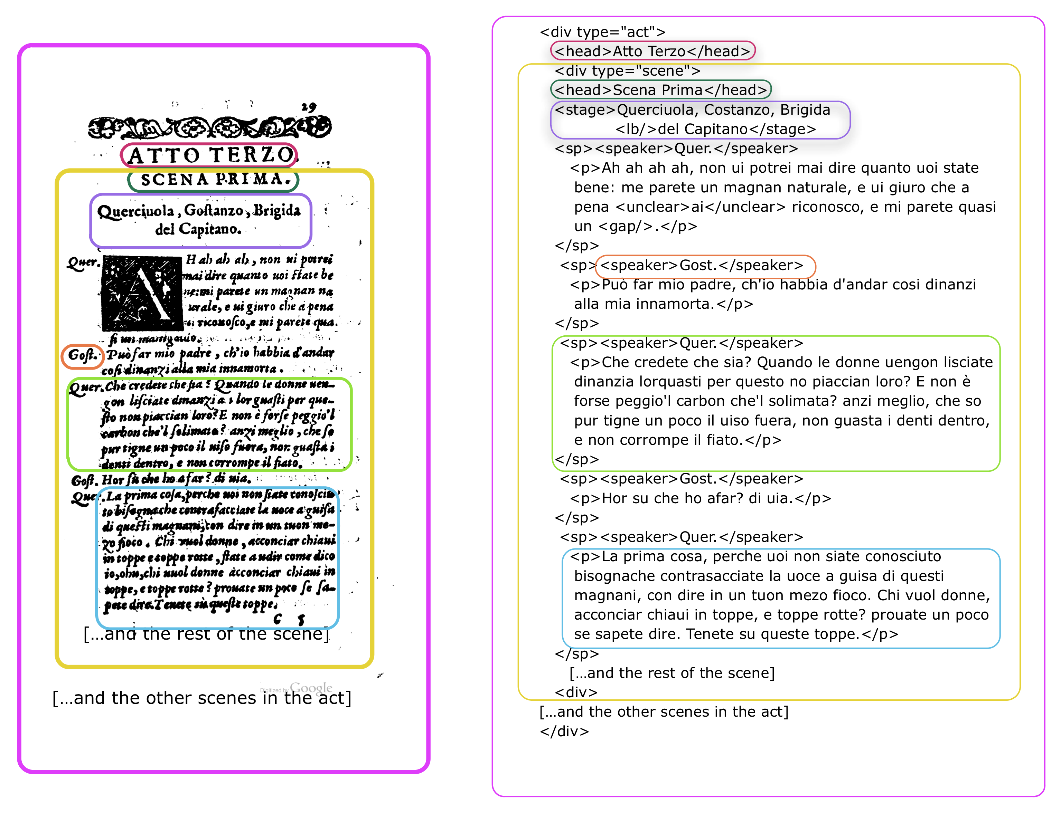
TEI as representing a research object
Let’s take a look at the process for modeling and mapping our documents.
In creating a TEI document, we are identifying and selecting pieces of the source document. We then represent these pieces as distinct elements in our TEI file: that is, distinct chunks of data with distinct boundaries. The example on this slide shows the how the markup mirrors the structure of the original text. The structural relationships are similar as well. As you can see, we have scenes within acts, paragraphs within speeches, etc.
Image from the Women Writers Project
Notes:
Just as XML provides a very specific way of structuring information and of looking at the world, TEI provides a means for talking about the structure of a document.

Slide 26
Xml as a means of structuring information
Notes:
XML provides a very specific way of structuring information and of looking at the world. It asks us to identify pieces of information that we are interested in, and it asks us to group them together. We can represent these groupings in various different visual ways, all of which represent the same thing—XML’s structure. The first useful metaphor is that of a set of nested boxes, like in this example. These boxes always nest perfectly within each other, and do not overlap.

Slide 27
Why TEI?
The TEI Guidelines provide a representational system—a system of notation through which we can create digital representations of our research materials.
TEI focuses our attention on translating our observations about texts into formal information. In this regard, TEI allows us to do many things that a printed image or simple transcription of the page would not.
When we do TEI encoding, different things about a text become manifest (depending on how we encode).
For instance, we can look at the people and places contained within a document, the way it quotes and cites other works, or how it has been revised over time. The TEI focuses our attention in a very particular way on the translation of observations about texts into formal information.
Notes:
When we do TEI encoding, different things about a text become manifest (depending on how we encode).
The TEI focuses our attention in a very particular way on the translation of observations about texts into formal information.

Slide 28
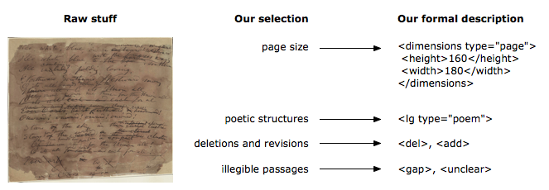
Formalism, selection, description
TEI serves as a kind of intermediary between our material and the formal analytics of a research process.
TEI also recognizes that not all documents are going to follow the models that we set up for them, so it navigates between creating a highly-constrained idealized model of the document, and a loose model in which anything is possible.
Based on research aims, we select the parts of the text that are of interest to us. We then describe them using a set of formal descriptors. Then we regulate and constrain (to some extent) our descriptions according to our expectations about genre and document structure.
What we are doing is selectively modeling our document. This means there are omissions, and distortions.

Slide 29
A sample fragment
This is a very simple example to demonstrate some basic markup; it has some basic features that are common to prose documents, such as:
a heading
a few paragraphs
a list
Along with some embedded features like names, quotations, and foreign words.
It’s worth noting before we even look at the markup that there’s already structure being expressed here. We notice from signals conveyed by typography and layout what structure is being conveyed.
Part of what we’re doing in our XML markup is translating these typographical cues into a form that a computer can understand
After nones
I leafed through the catalogue, and a feast of mysterious titles danced before my eyes:
Algebra by Al-Kuwarizimi
Gesta francorum
De pentagono Salomonis
I was not suprised that the mystery of the crimes should involve the library. For these men devoted to writing, the library was at once the celestial Jerusalem and an underground world on the border between terra incognita and Hades...
I made bold to ask for further information. Malachi looked at me sternly: “Perhaps you do no know, or have forgotten, that it right and sufficient that only the librarian know how to decipher these things.”

Slide 30
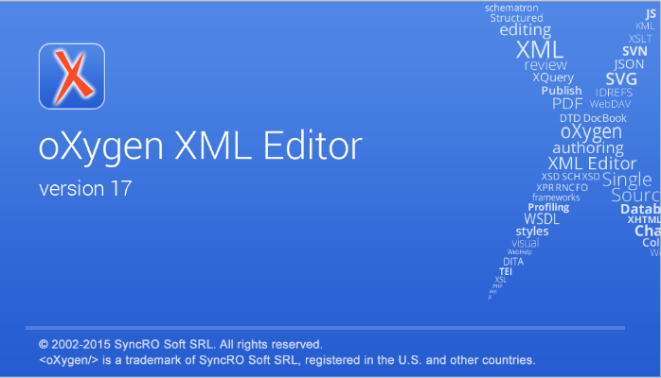
Let’s try it out

Slide 31
A sample fragment
Add the following tags to our unmarked up text in order to form elements:
First, lets mark-up the basic structure
There are several levels of structure being represented here, large-scale, mid-level, and small.
Large-scale elements, like the <div> in this example represent major document divisions. In the TEI, <div> provides us with basic structural chunks, and can nest recursively inside itself.
Mid-level structural elements in this passage are <head>, <p>, <list> and <item> These can go inside a major division, and they contain words and phrase-level elements.
The small elements represent individual words and phrases. In this passage, they are <name> and <emph>
<div type="chapter">
<head>
<p>
<name>
<emph>
<list>
<item>

Slide 32
A sample fragment
Now lets mark up the quotation. Which TEI element should we choose?
http://www.tei-c.org/release/doc/tei-p5-doc/en/html/CO.html#COHQQ
Lets mark up the titles of the titles of works.
http://www.tei-c.org/release/doc/tei-p5-doc/en/html/ref-title.html
We should also use the xml:lang attribute to indicate that the content of an element is in Latin.
Finally lets add some attributes to the different names we found.
http://www.tei-c.org/release/doc/tei-p5-doc/en/html/ref-name.html
Are there other types of ways to form these elements? See for instance: http://www.tei-c.org/release/doc/tei-p5-doc/en/html/ND.html#NDPER

Slide 33
More Elements
After nones
At the Day of Judgment we shall not be asked what we have read, but what we have done.
I leafed through the catalogue, and a feast of mysterious titles danced before my eyes:
Algebra by Al-Kuwarizimi
Gesta francorum
De pentagono Salomonis
I was not suprised that the mystery of the crimes should involve the library. For these men devoted to writing, the library was at once the celestial Jerusalem and an underground world on the border between terra incognita and Hades...
I made bold to ask for further information. Malachi looked at me sternly: “Perhaps you do no know, or have forgotten, that it right and sufficient that only the librarian know how to decipher these things. For as the psalmist says: To the making of many books there is no end, and much devotion to them is wearisome to the flesh.
Read up on our new element!
http://www.tei-c.org/release/doc/tei-p5-doc/en/html/ref-epigraph.html
and
http://www.tei-c.org/release/doc/tei-p5-doc/en/html/examples-bibl.html

Slide 34
More Elements
Here we have even more elements.
We’ve added an epigraph which contains a quote as well as the bibliographic information about where the quote came from (in bibl, title and author).
We can also record quotes and the names of works within the running text of the chapter.
Note that all of the possible encodings we’ve recorded in the past three slides are valid. Depending on the aims of your project, you could have employed any of the above encodings—or even more complex ones, if your project is invested in recording other textual features.

Slide 35
EpiDoc
EpiDoc is an international, collaborative effort that provides guidelines and tools for encoding scholarly and educational editions of ancient documents. It uses a subset of the Text Encoding Initiative's standard for the representation of texts in digital form and was developed initially for the publication of digital editions of ancient inscriptions (e.g. Inscriptions of Aphrodisias, Vindolanda Tablets).
Its domain has expanded to include the publication of papyri and manuscripts (e.g. Papyri.info). It addresses not only the transcription and editorial treatment of texts themselves, but also the history and materiality of the objects on which the texts appear (i.e., manuscripts, monuments, tablets, papyri, and other text-bearing objects).

Slide 36
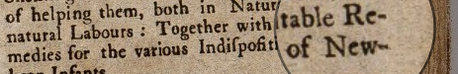

EpiDoc Guidelines
When working with epiDoc, it helpful to acquaint yourself with the transcription guidelines in order to answer questions such as….
What do I do if a word is divided across a line? How do I handle an abbreviation, what about something that is illegible?
<lb n="2"/>Together with table Re-
<lb n="3" break="no"/>medies…..
The EpiDoc Guidelines recommend a rather restricted set of TEI elements, content models, attributes and values, such that an EpiDoc file is always also a valid TEI file, but not every TEI file is valid EpiDoc. Where the EpiDoc Guidelines are more restrictive than the TEI, the former should be considered to supercede the latter; but where the TEI goes into more detail, or offers a more useful range of examples, it should of course be consulted and considered the canonical source for all EpiDoc usage.

Slide 37
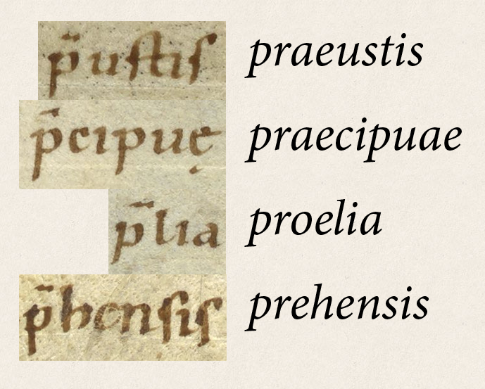
Abbreviations
For example, in the case of "QQ" expanding to "q(uin)q(uennalis)", we might encode as follows:
<expan>
<abbr>q</abbr>
<ex>uin</ex>
<abbr>q</abbr>
<ex>uennalis</ex>
</expan>
http://www.stoa.org/epidoc/gl/latest/trans-abbrevfully.html

Slide 38
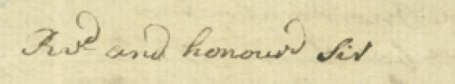
Abbreviations

Slide 39
Abbreviations
<ab>
<lb n="1"/><expan><abbr>Rv<hi rend="superscript">d</hi></abbr>R<ex>e</ex>v<ex>eren</ex>d</expan>and honoure<hi rend="superscript">d</hi> sir.</ab>
When Epidoc is unclear—consult the TEI directly!
http://www.tei-c.org/release/doc/tei-p5-doc/en/html/ref-ex.html

Slide 40
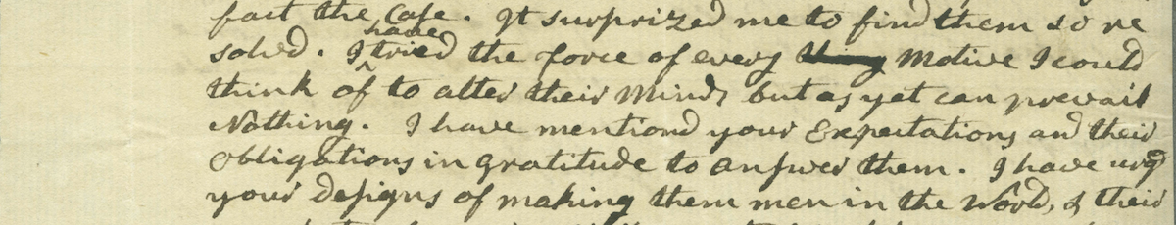
Difficult to Read and Illegible text and Editorial changes
<ab>
<lb n="4"/>solved. I <add rend="insert" place="above">have</add> tried the force of every <gap reason="illegible" extent="unknown" unit="character"/>motive I could
</ab>
http://www.stoa.org/epidoc/gl/latest/trans-additionwithmark.html
http://www.stoa.org/epidoc/gl/latest/trans-illegiblecharunknown.html

Slide 41


Slide 42
Let’s try it out

Slide 43
XSLT
Unlocking your markup

